Slide 1
Propensity Score Intuition
Needs to be finished.

Slide 2
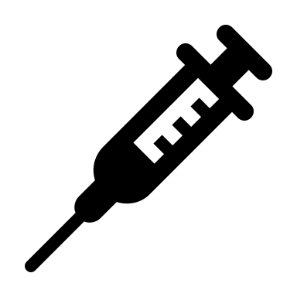




Partial Verification
Omniscient View
P(Test | Man) = 50%
P(Test | Woman) = 25%
10 of 24 have hypercapnia
5 of 12 men
5 of 12 women
Clinicians can’t perfect predict who needs the test
OR_{test|hypercap}: 2.8 (M or W)

Slide 3
Partial Verification

Slide 4



‘Data/Methods’ Limitations:
P(ABG) = 0.5
P(ABG) = 0.25
‘Partial Verification’: hypercapnia status is only ascertained in patients who get an ABG.
  Analysis: Among patients who have ABGs checked
  Target: Among all patients who may have hypercapnia
The probability of getting an ABG is variable and idiosyncratic
  Inverse probability of blood-gas weighting?
    Missing data is tricky
True Status (unobserved)
Observed w/ Hypercapnia
Weighted by Inverse of Prob
The Missing Indicator Method.
CMAJ 2012
Notes:
DOI:https://doi.org/10.1016/j.jclinepi.2022.01.022
If you assume that the missing data (ie. who gets an ABG) is predictable based on health record elements, you can weight the ones that did get ABGs properly.
This is challenging to do with missing data of other types (ie. of the predictors).
Missing data that is just entirely random: MCAR
Missing data that is predictable: missing at random (a variation of this covariate-dependent missing completely at random (CD_MCAR) – does not allow outcomes to predict
Missing data that is not predictable: NMAR – e.g. happens when the data is missing due to some factor you can’t measure.
Missing-data category = still creates biased estimates.

Slide 5
Partial Verification Bias

Slide 6
50% prevalence; both sexes
Omniscient View
Our goal is to predict who has the condition in the entire sample
Notes:
[ ] from the diagnostic test accuracy literature.

Slide 7
Only some tested

Slide 8
66% prevalence; mostly women
Complete Case
If you train the model on this, it’ll learn that sex predicts the condition.
True! among people who get the test

Slide 9
Only some tested
But we are particularly interested in predicting for people who didn’t get the test

Slide 10
Correctly modeled propensity score*
33%
33%
100%
100%
100%
33%%
Notes:
*Propensity model must account for all factors that relate to P(Test) and P(Condition|Test)

Slide 11
1/.33
3
1/.33
3
1/1
1
1/1
1
1/1
1
1/.33
3
Inverse Propensity Weights

Slide 12



Weighted (pseudo)population restores prevalence and sex balance of the whole population
Intuition:
If someone who was unlikely to get the test but did and they have the condition → there are likely many similar patients with the condition that didn’t get the test.

